Slide 1



2025S_CSCI441_VB_Software Engineering
Demo #1
DIGITIZED LIBRARY MANAGEMENT SYSTEM
Instructor: Dr. Mike Mireku Kwakye
Member: Antony Reyes Pilo, Channet Lor, David Harmon, Matthew Herrick, Viraksith Huor

Slide 2




Table of Contents
1
4
Introduction
Explanation Project UI
2
Simple Visual Showcase (Demo)
5
Showcasing the test of our website
3
6
Outro of presentation (Sum Up)
Explanation Project API

Slide 3
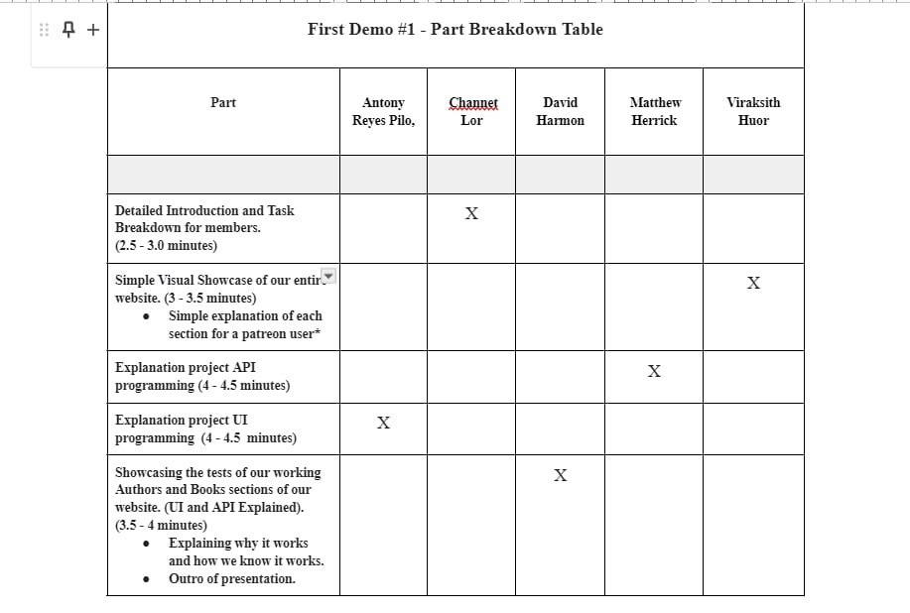

Slide 4


1. Introduction
The Digitized Library Management System is a modern solution designed to transform the traditional library experience into a streamlined, efficient, and user-friendly digital platform.

Slide 5
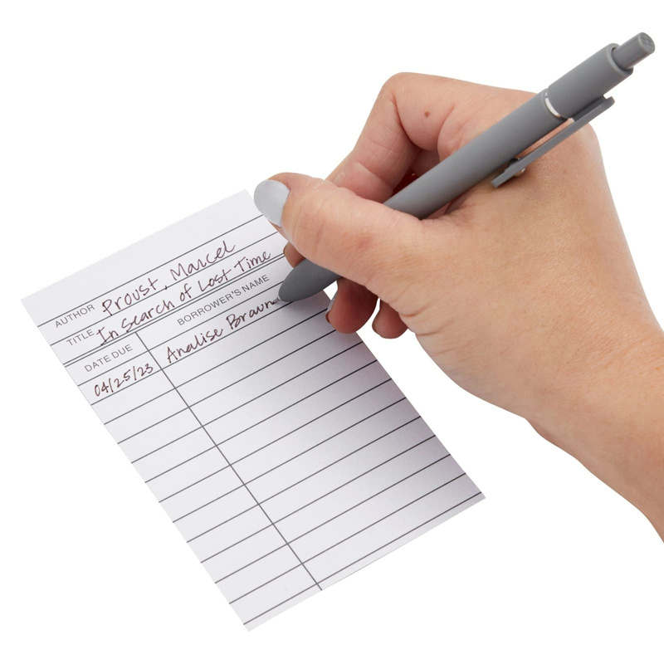

1
Problem
In many libraries today, managing books, tracking borrowers, and organizing author information is still done manually—leading to errors, delays, and limited accessibility.
Solution
This project aims to solve those issues by creating a centralized system that allows users to easily browse books and authors, manage their accounts, and interact with library resources online.
This project will show how technology can change the way we manage information and improve the useful of digital world ensuring libraries stay relevant in the digital age.

Slide 6
2. Simple Visual Showcase
(Demo)

Slide 7
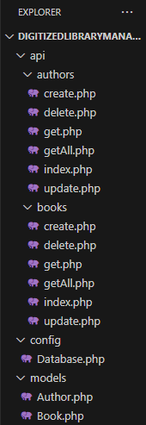

Matthew Herrick
3. Back-End API
We've developed a PHP-based REST API that provides a comprehensive solution for managing a library's books and authors catalog. The system is built using object-oriented programming principles and utilizes a PostgreSQL database for robust data storage.
Books Management
Root Folder Directory
Create: Add new books with title, ISBN, genre, publication year
Read: Retrieve all books or filter by various parameters
Update: Modify book information.
Delete: Remove books while automatically handling related records
Authors Management
Create: Add new authors to the system
Read: Retrieve all authors or find by name or ID
Update: Modify author information.
Delete: Remove authors while automatically handling related records

Slide 8
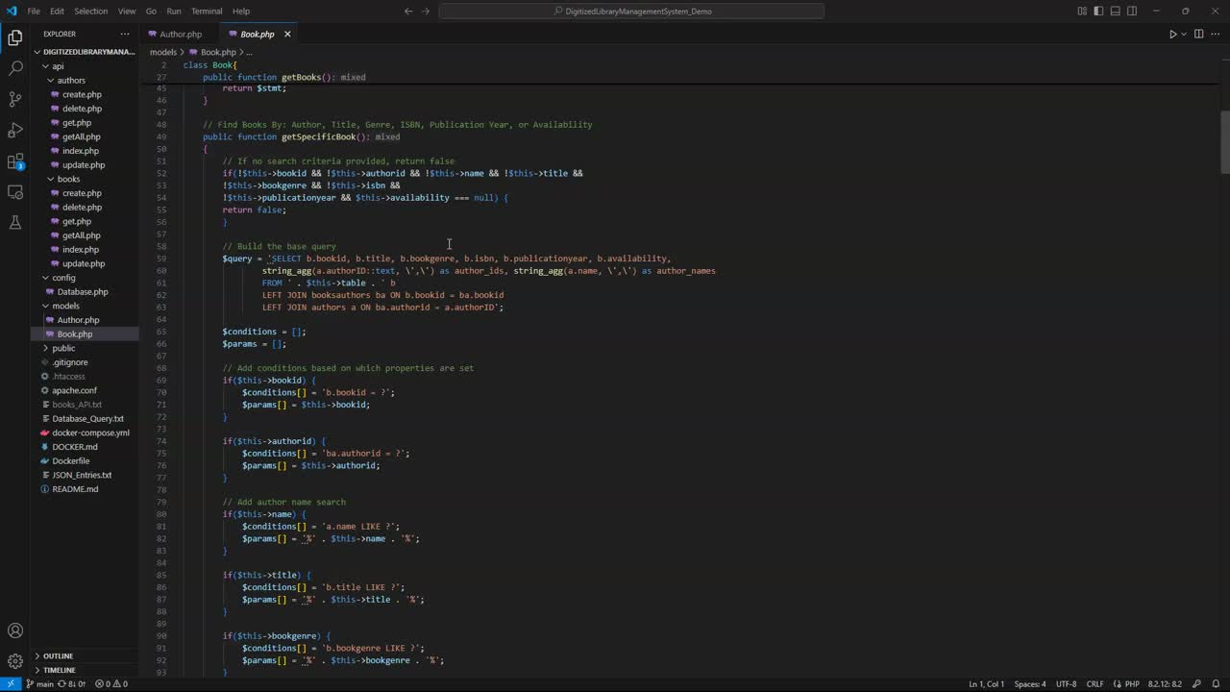
Matthew Herrick
Back-End API continued
Book Model

Slide 9
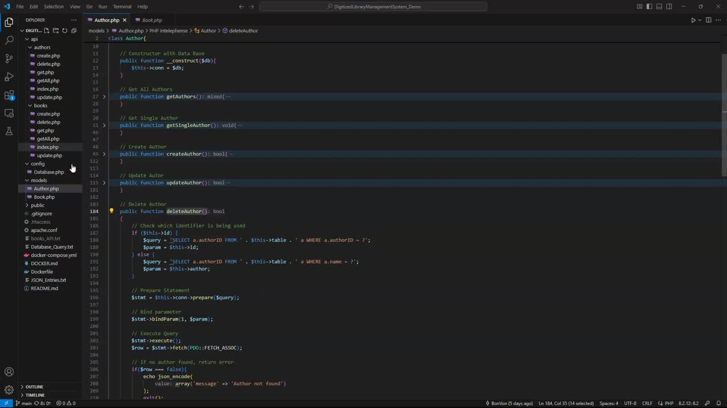
Matthew Herrick
Back-End API continued
Author Model/API

Slide 10
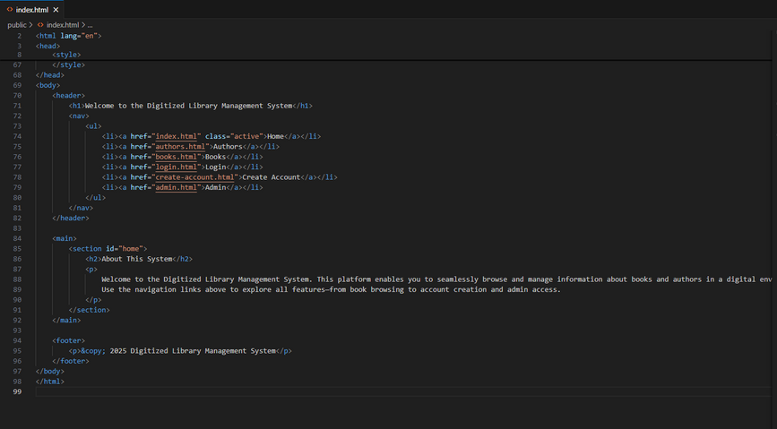
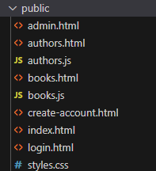
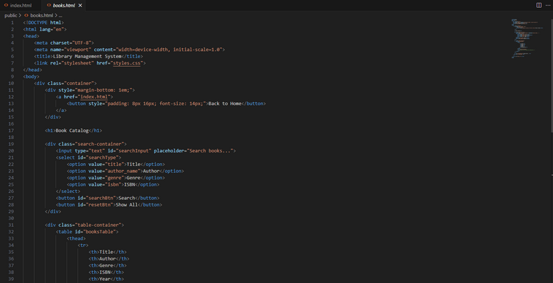
4. Explanation Project UI
The project’s UI for our website’s DigitizedLibraryManagementSystem_Demo consisted of the .html files and the style.css file. These files are the links that you are able to click on when you choose view the authors, books or create an account. Any sort of visual button, color, index, or format that you see on our website will be refered to as the UI or User-Interface.

Slide 11
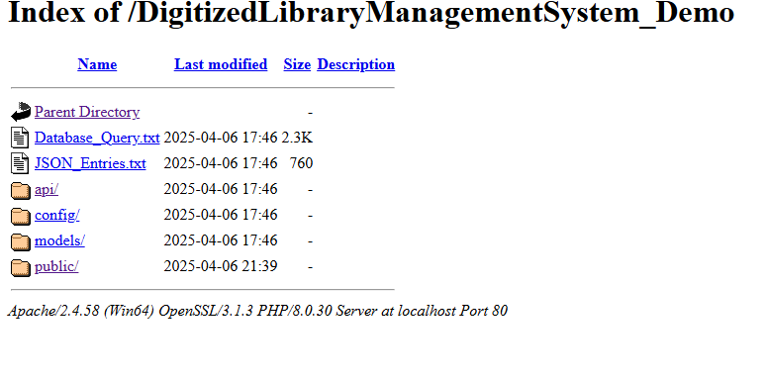

5. Showcasing the test of our website
API
User-Interface
Website’s Structure
The API handles all communication between the user interface and the database. It includes endpoints for creating, reading, updating, and deleting authors and books.
The UI is a set of HTML and JavaScript files that allow users to manage books and authors through a clean and interactive design. It communicates with the API using fetch requests to display and modify data in real time.
The project is organized into folders for API logic, data models, configuration, and public-facing files. This structure separates concerns, making the codebase more maintainable and scalable.

Slide 12
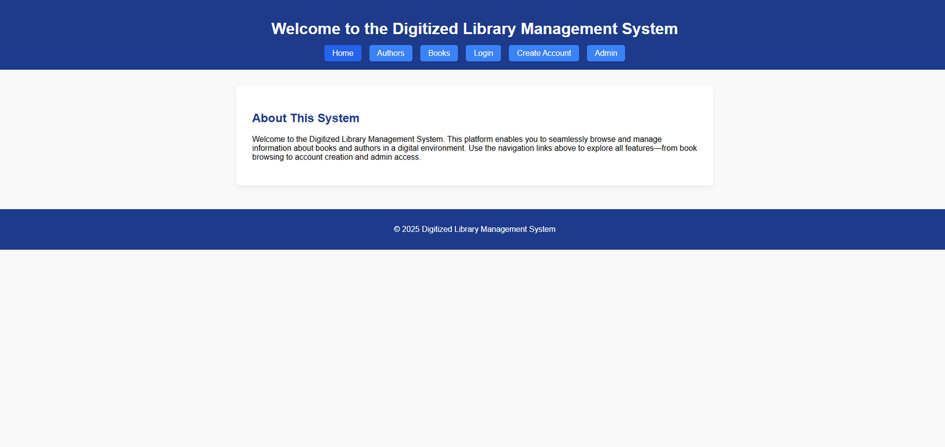
6. Outro of Presentation
(Sum Up)
In summary, our website is built with a clear structure that separates the API, user interface, and backend logic. The API acts as the bridge between the UI and the database, handling all data operations. The user interface provides a simple and responsive way for users to manage library content, while the organized project structure ensures the system is easy to navigate, maintain, and expand.

Slide 13

THANK YOU!
Digitized Library Management System

